Slide 1
Introduction to the
Science & Technology Fair
By Trev

Slide 2
Science & Technology Fair
Fair, Prizes, and the Future
Timetable
Ideas and Action
Some projects Trev isn’t fond of
Fair Testing
Log book and project write up
Example Projects

Slide 3
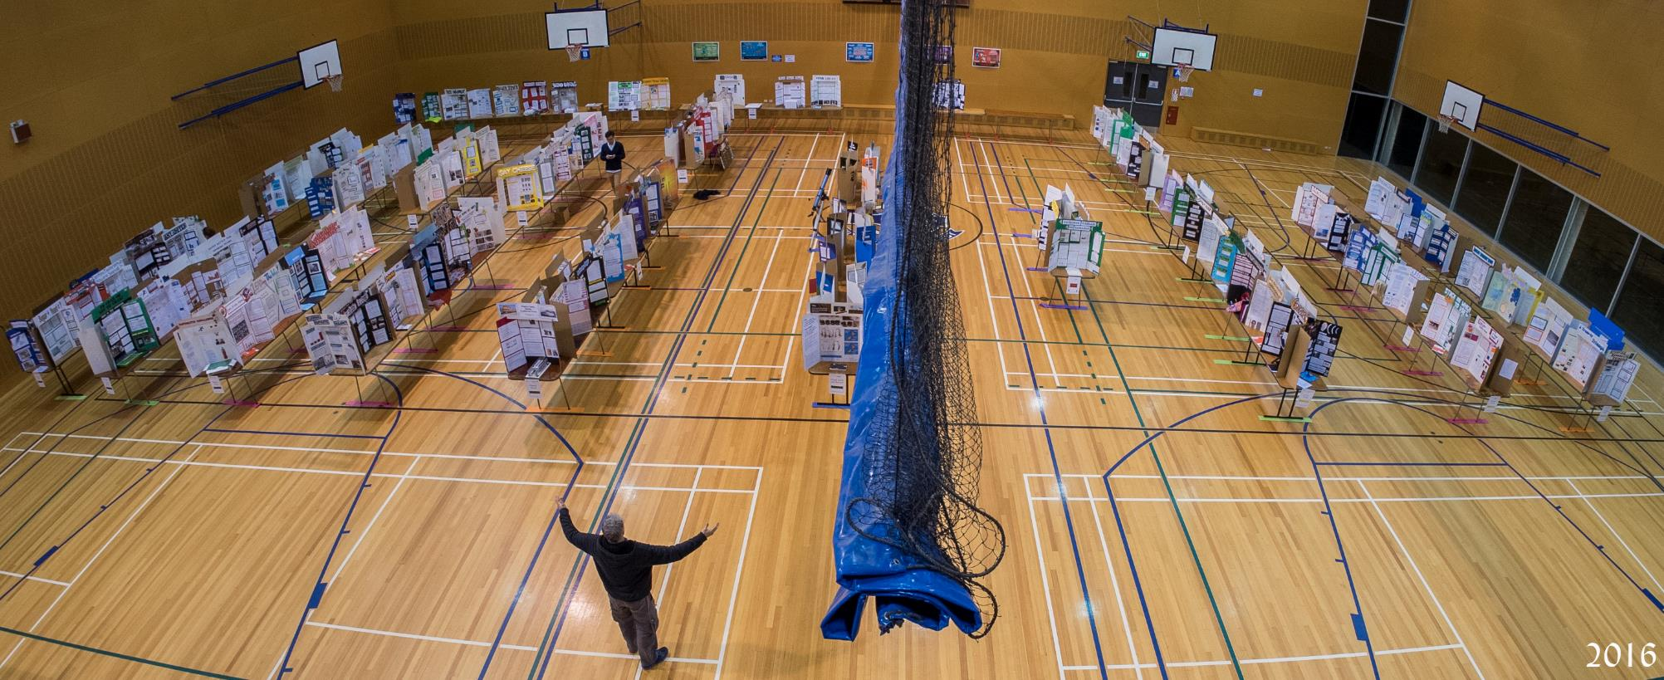

Slide 4
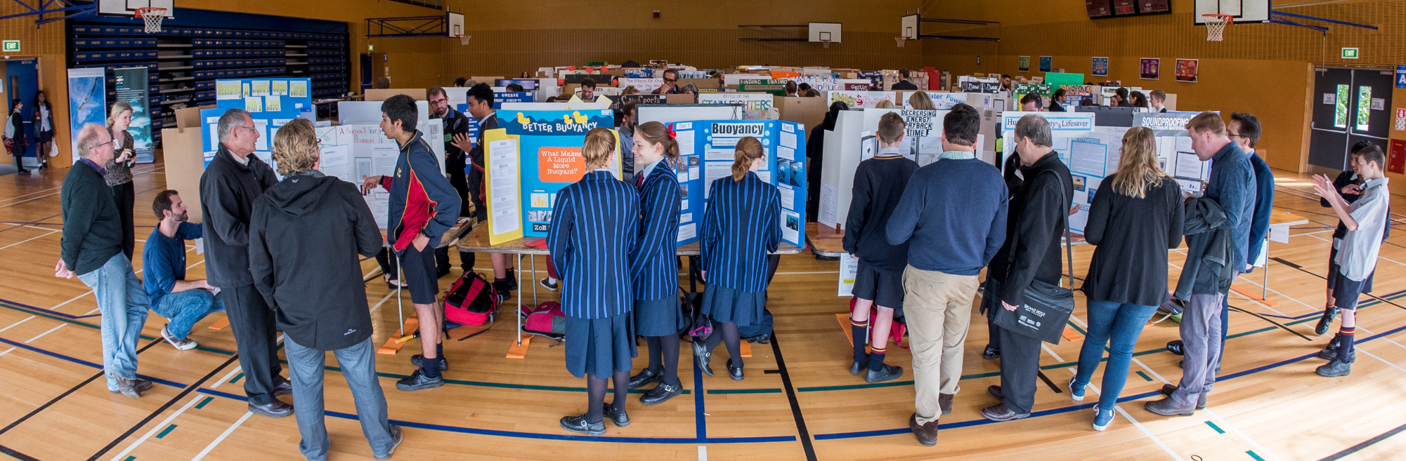

Slide 5
Fair, Prizes, Future
Fair
Prizes
Future
Science projects:
Study the world to find out something new. Is there a question that you can answer by doing a test or making observations?
Technology projects:
Can you put something together from things that already exist to make life better?
Over 5 thousand?!! Lots!
Realise the Dream
Crest Awards
(auto entry with good projects)
PM Science Prize

Slide 6
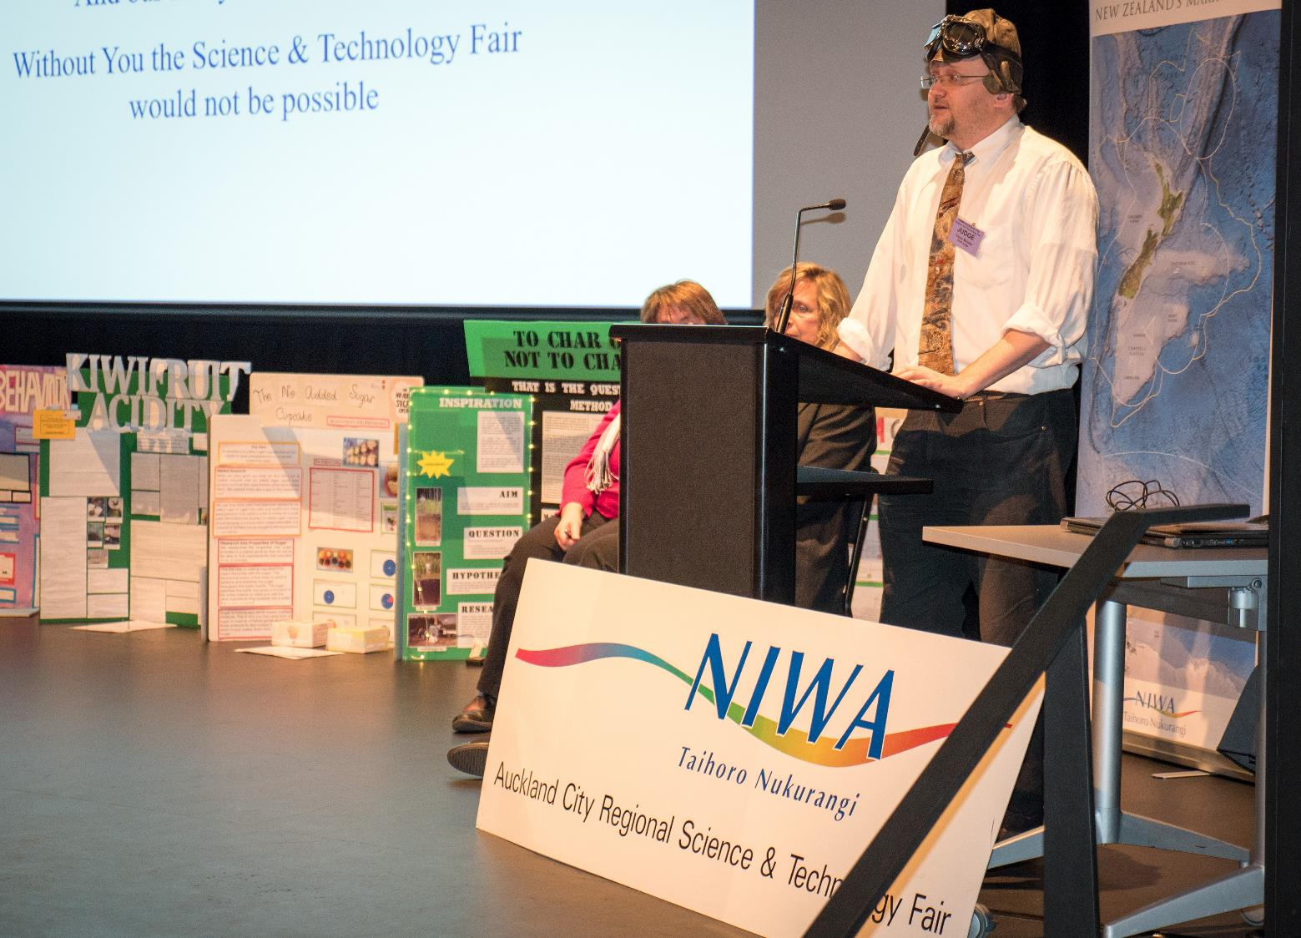

Slide 7
Timetable
Term 1 - Science Skills, Fair Testing, Idea Research
Term 2 - Complete project! (Doesn’t that sound easy?)
Term 3 - Week 1 - Projects due for school fair! (Friday)
Term 3 - Week 2 - Judging!
Term 3 - Week 3 - Finalists prep and complete time
Fair Dates: Thursday 31st August – Saturday 2nd September

Slide 8
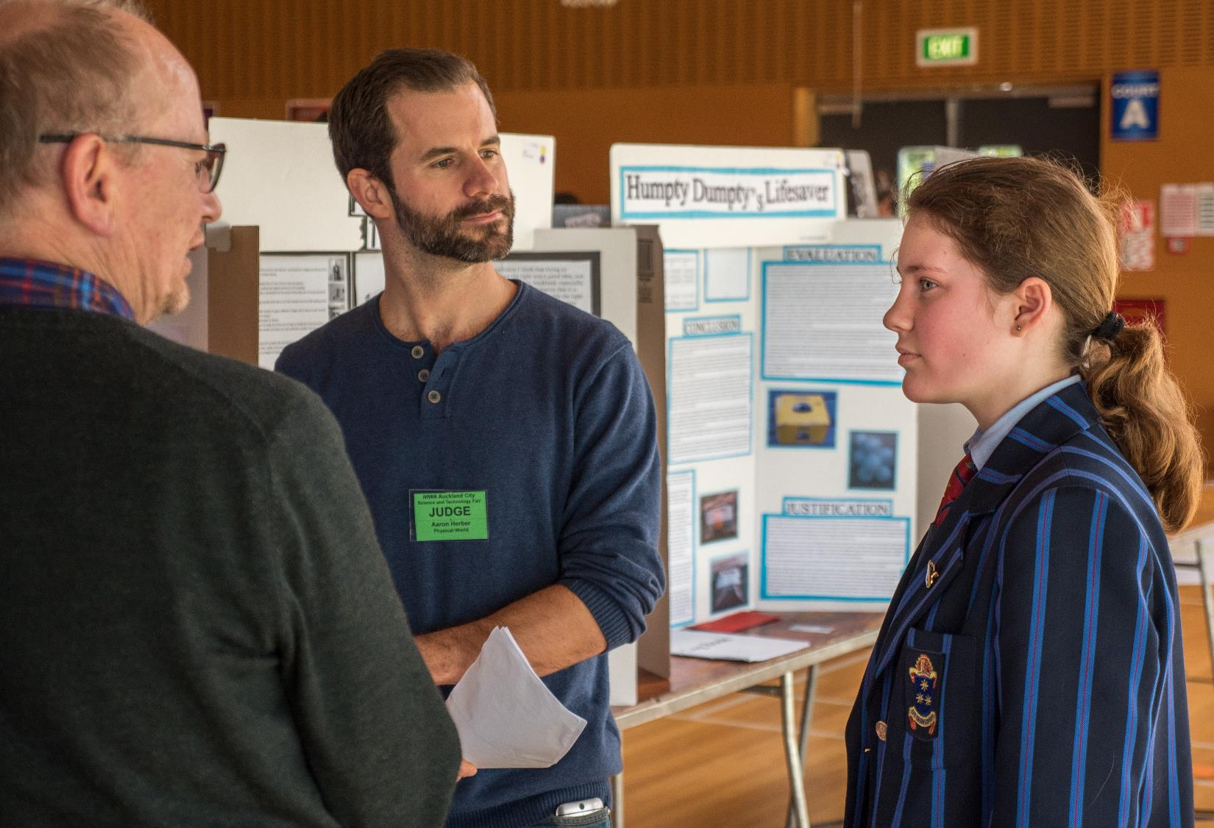

Slide 9
Ideas & taking action
Understanding writers block – they have a problem writing because they are afraid to write, not because they don’t have something to write about. Don’t put things off - read something or writing something today!
Understanding the mindset of the master procrastinator – they have all the plans in the world, “oh I’m going to be a lawyer, I’m going to be a fireman, I’m going to…” but they never do anything because they don’t make a plan to get there and follow it step by step. You don’t have to understand the last part of the story, just the step you need to take now.

Slide 10
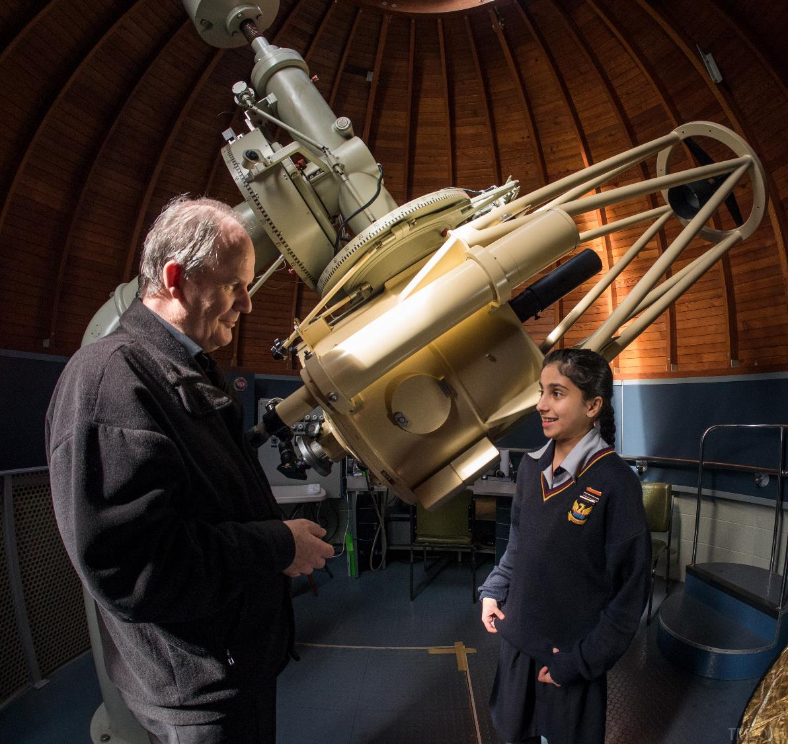

Slide 11
Ideas & taking action
Getting ideas – try reading. Because either you’ll get interested in a topic you don’t know anything about (what makes the sky blue?) or learn science related to something you do already, eg. a sport you play.
Take action – sports teams have training times.
Set time for Science and do it!
Aim - I have chosen to investigate
Introduction – I chose this because
Hypothesis - I think that my investigation will show… and I think this because…

Slide 12
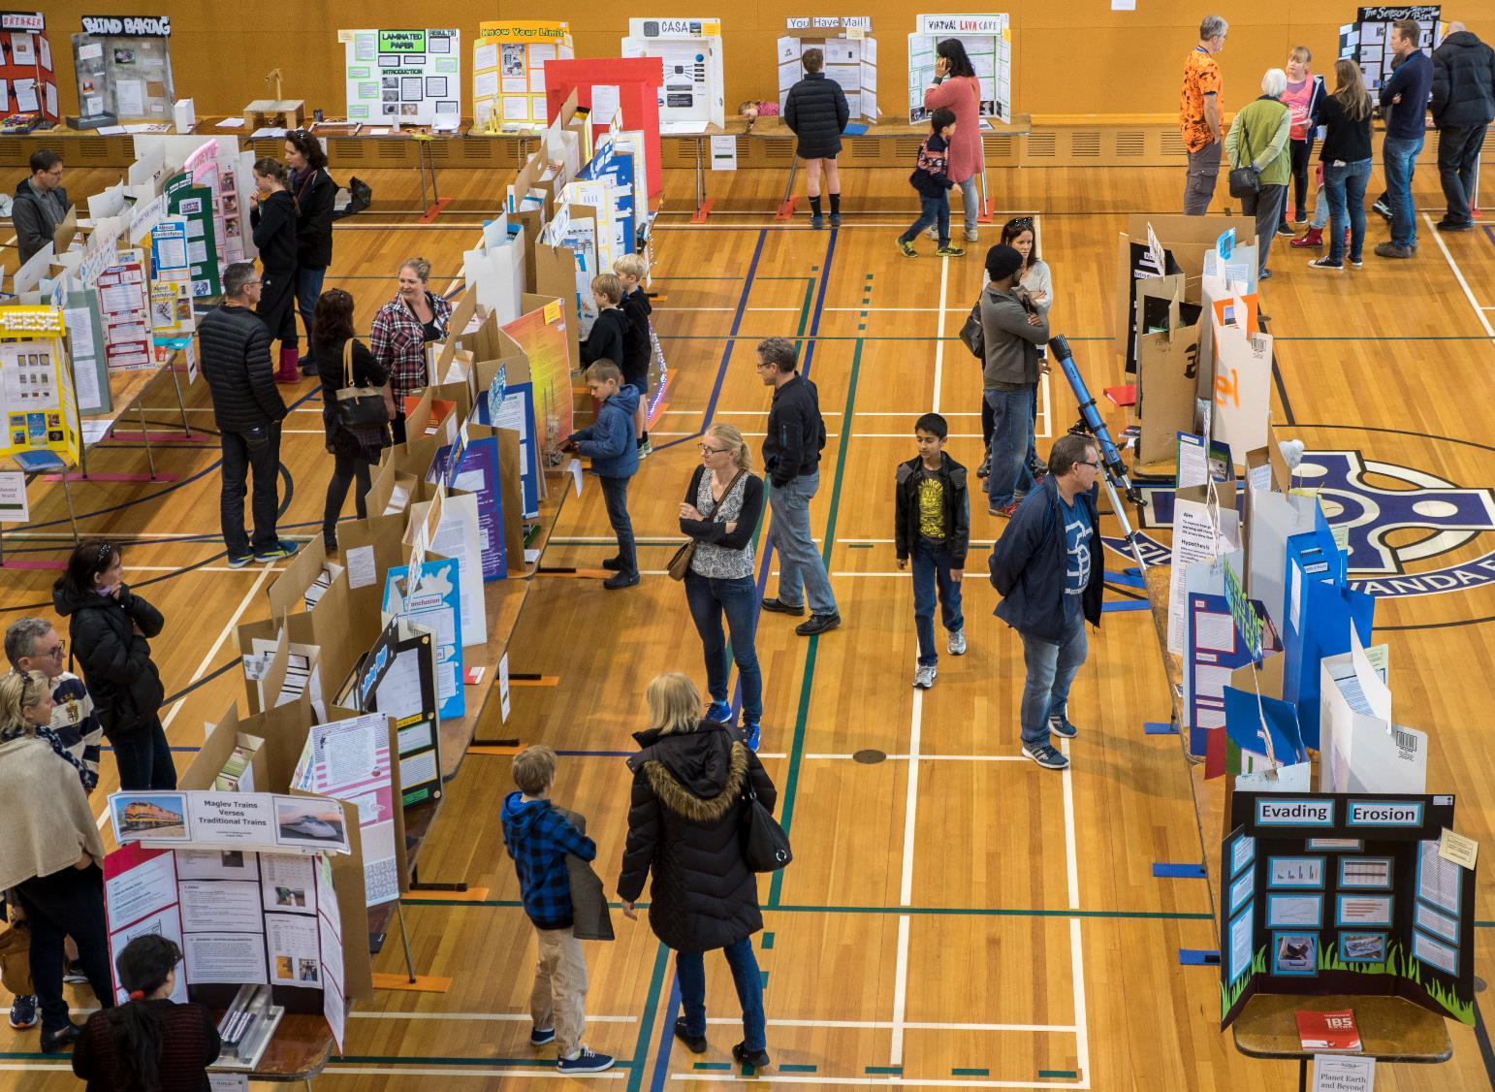

Slide 13
Projects that don’t shine brightly
Plants under coloured plastic – everybody does it, try to be unique
Growing mould on bread – ewww. At the very least take pictures, don’t attach real mouldy bread to your project
All the different soft drinks – usually ends up being product testing. How will your project stand out?

Slide 14
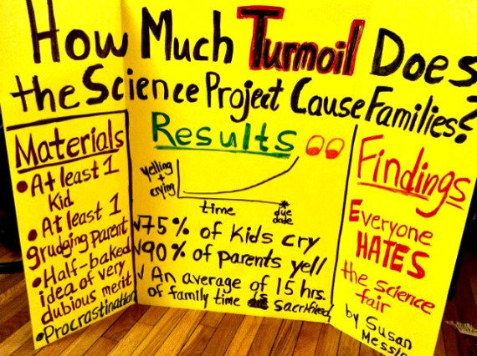


Slide 15
Fair testing
Change one thing! Measure one thing! Keep everything else the same!
Can you make a graph from the data you record?
Product testing issues – This can be a pre-test to discover the one product you want to experiment with.
Psychological testing issues – can the results be turned into numbers for a graph?
Biology, Chemistry, Physics, Earth Science, Astronomy – and don’t forget NIWA, ie. if appropriate, discuss a wider application of your work to the environment.

Slide 16
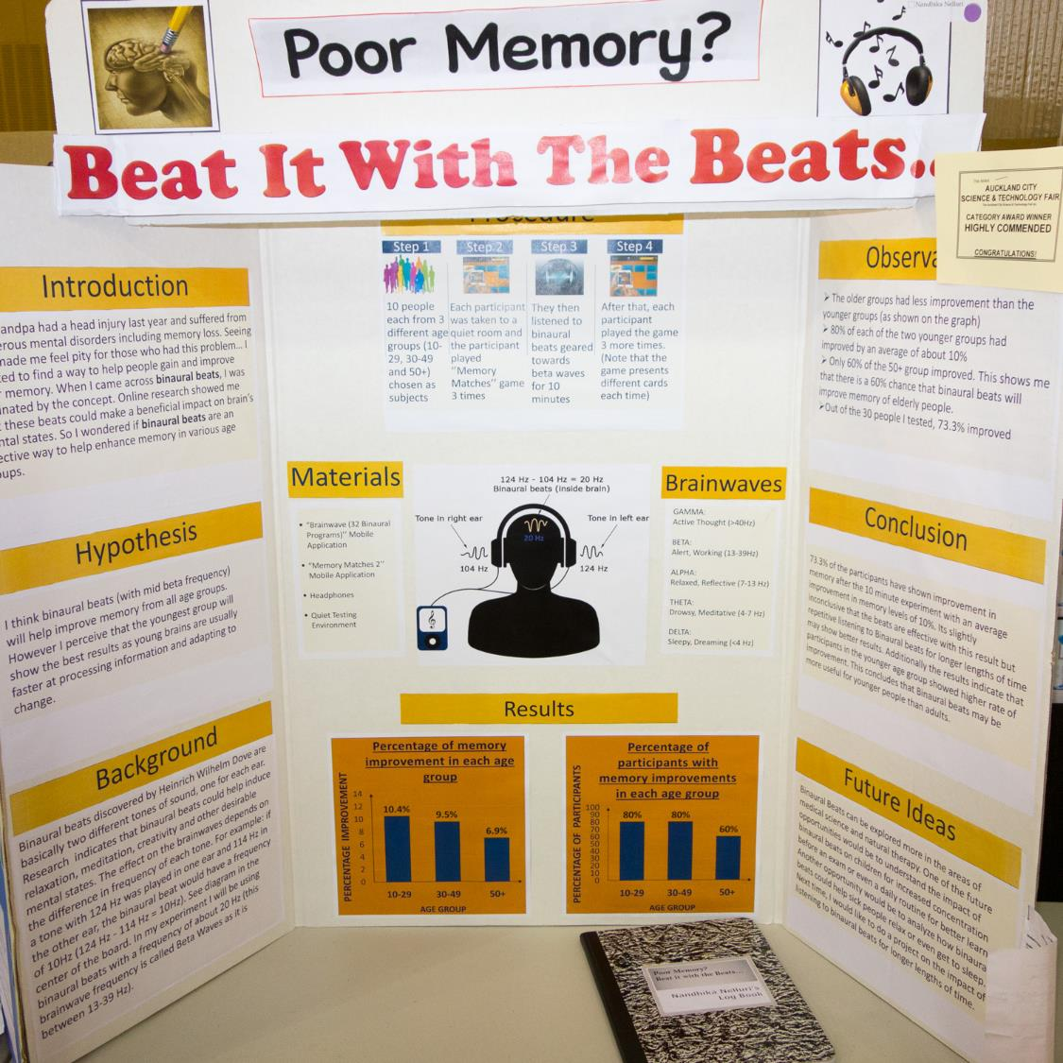

Slide 17
Log book
Write everything you do and put the pictures you take into a Word document. This becomes your log book!
Everything including your final project write-up goes into the document and will be emailed or shared with your teacher. It will be proofed by your teacher before it is printed and/or put onto a display board.
Winning school projects will need to go onto project boards and time spent on revising and improving it.

Slide 18
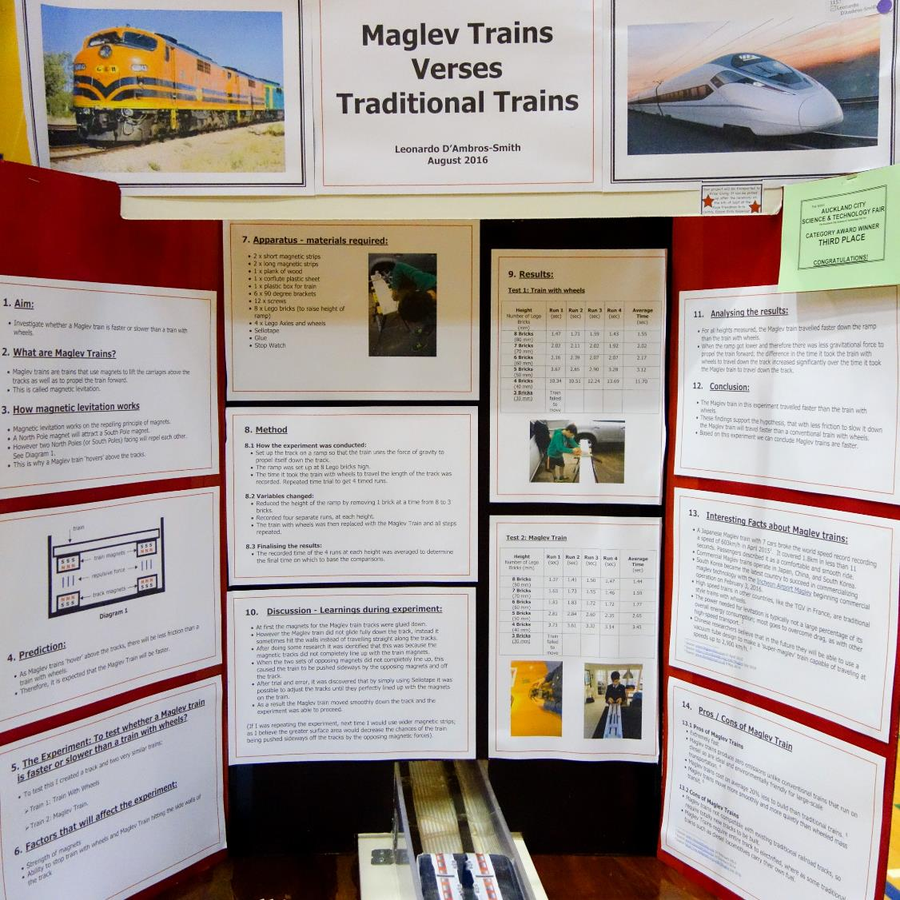
Some projects from 2016 – auto advance every 8s.
Maglev Trains

Slide 19
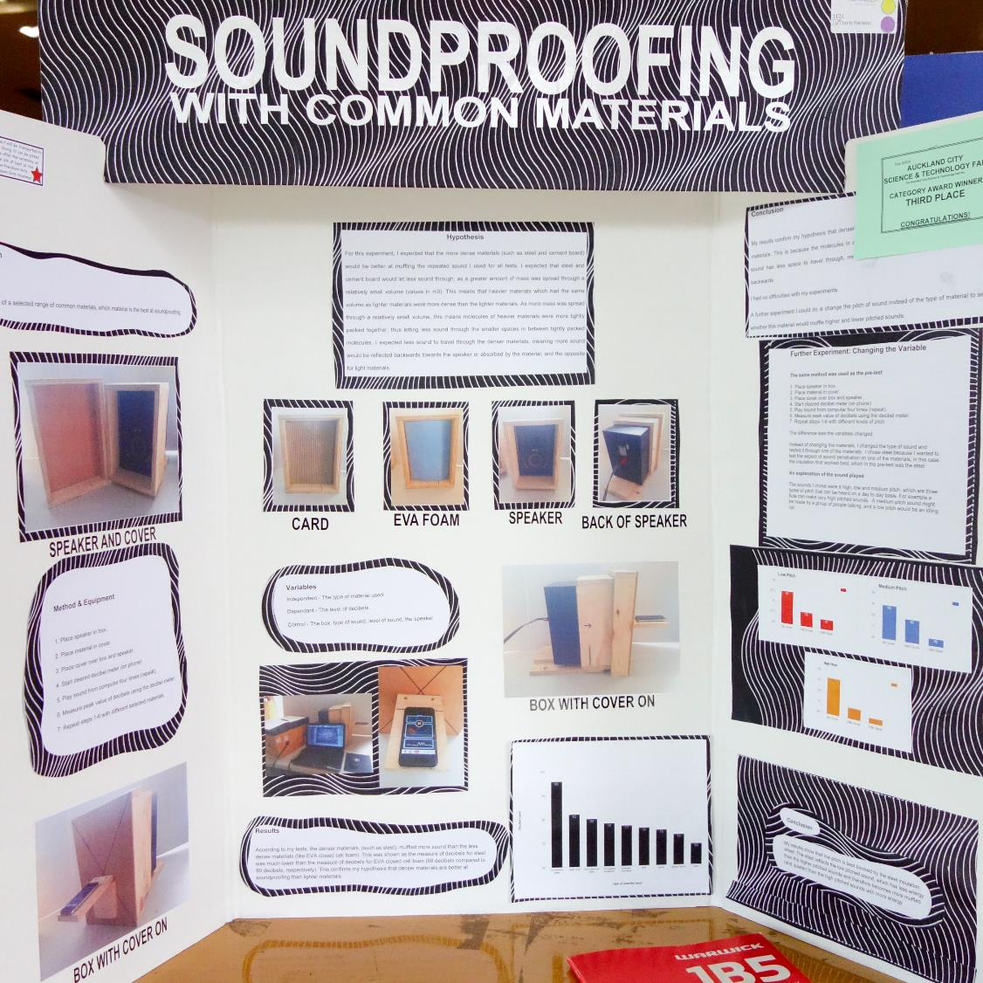
Soundproofing

Slide 20
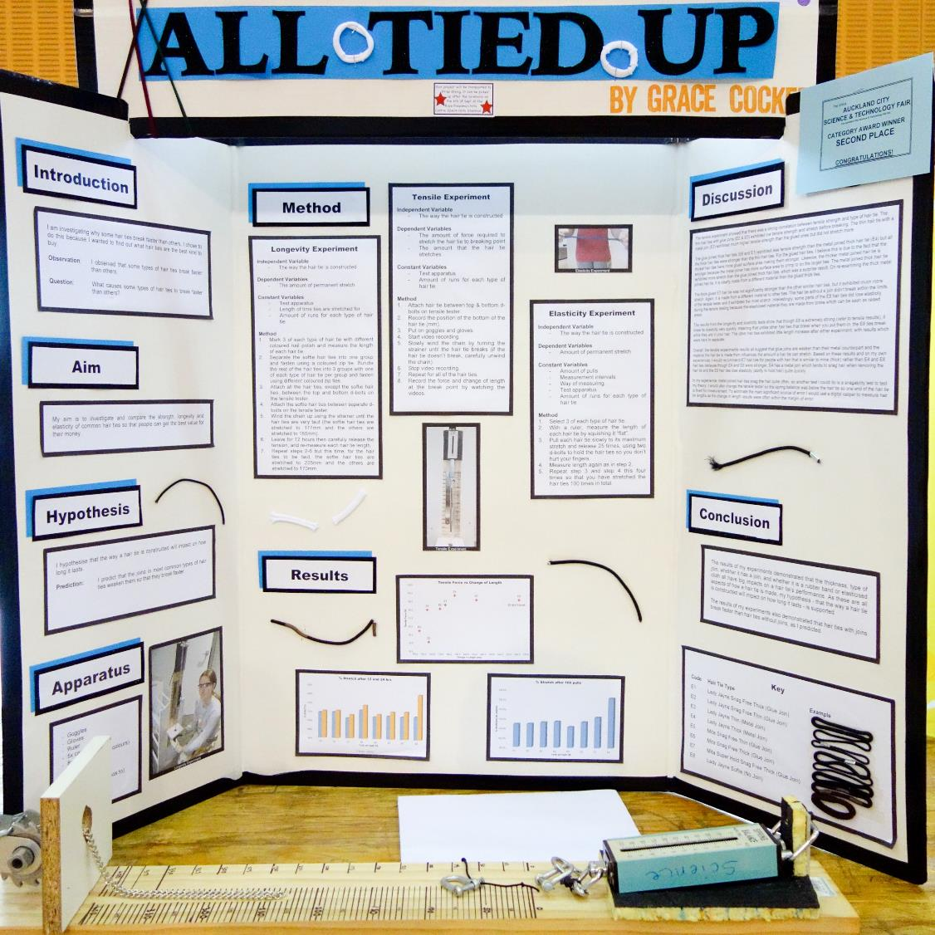
Hair Tie Strength

Slide 21
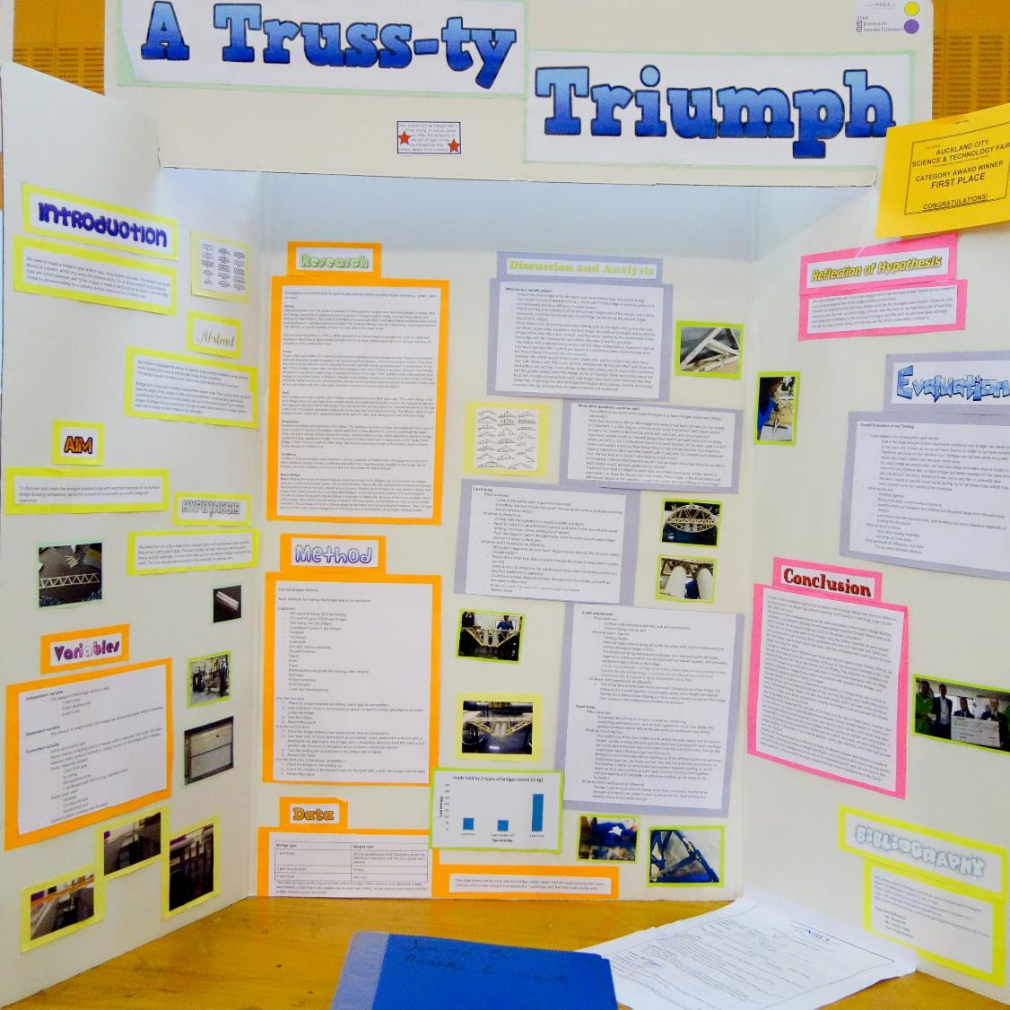
Bridge Truss Strength

Slide 22
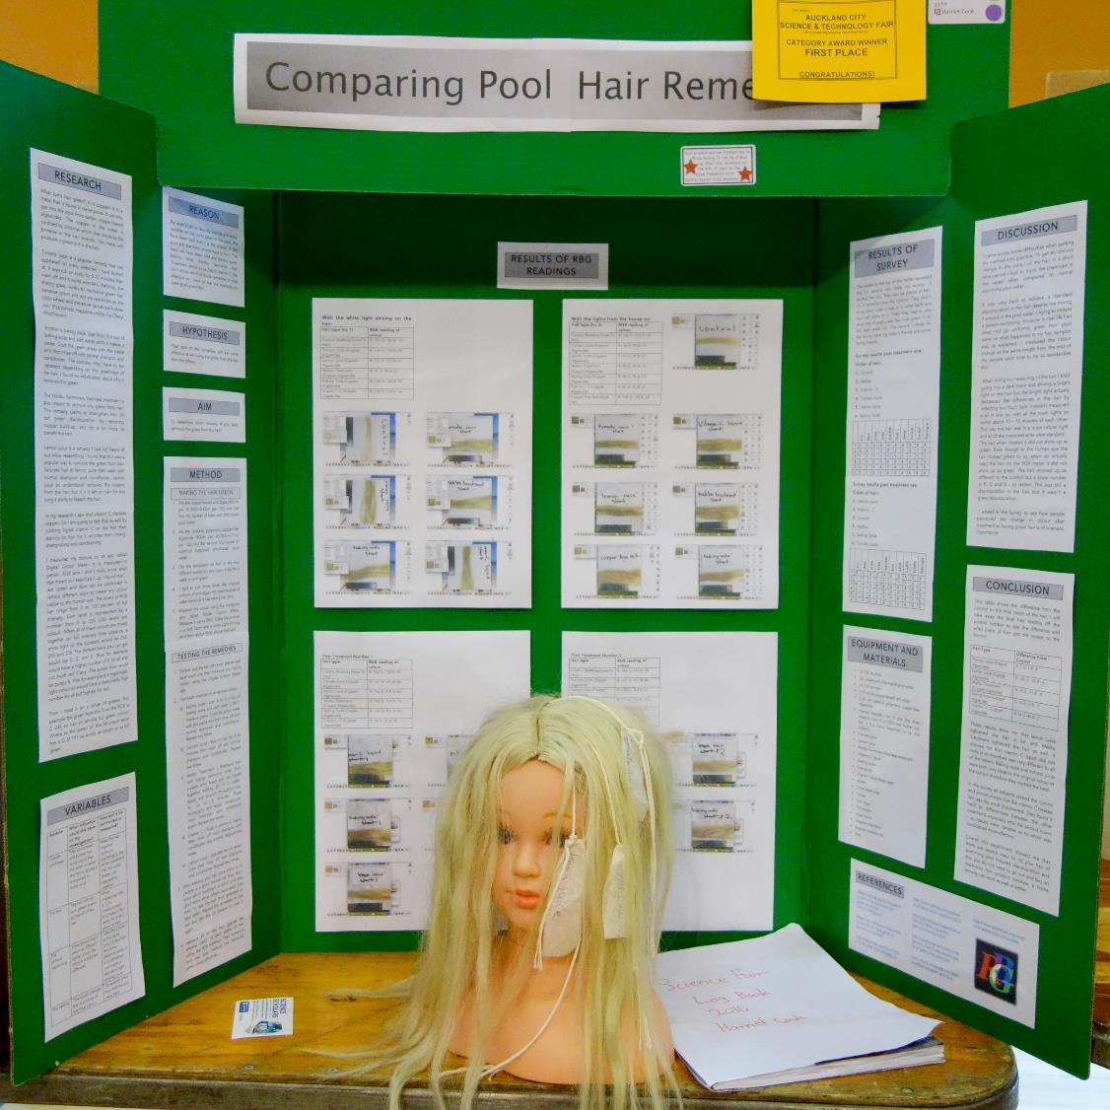
Pool Hair Remedies

Slide 23
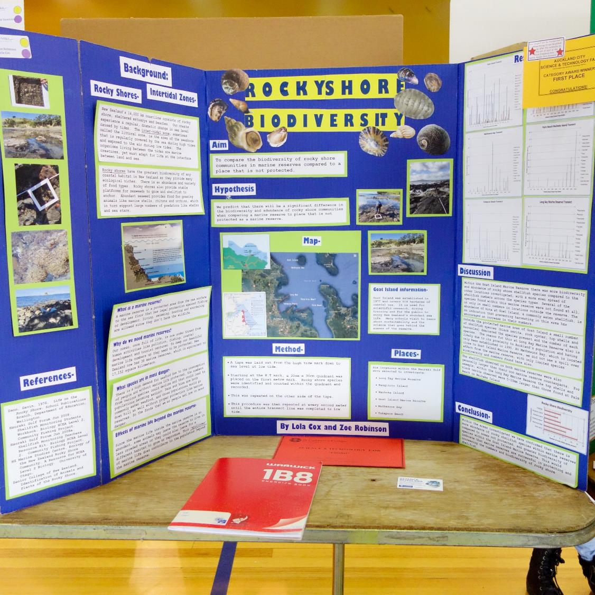
Rocky Shore Biodiversity

Slide 24
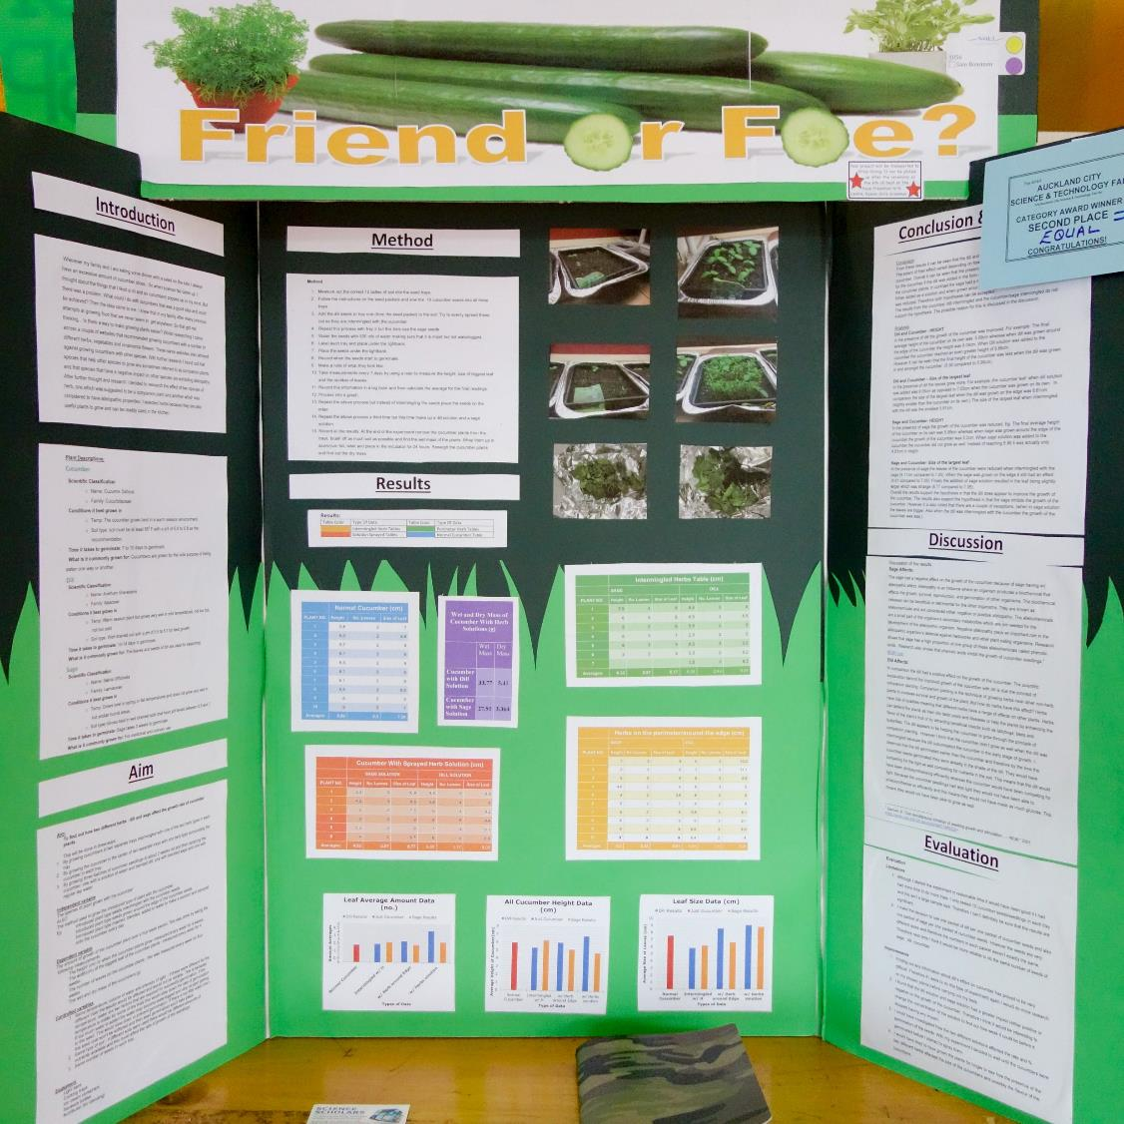
Companion Planting

Slide 25
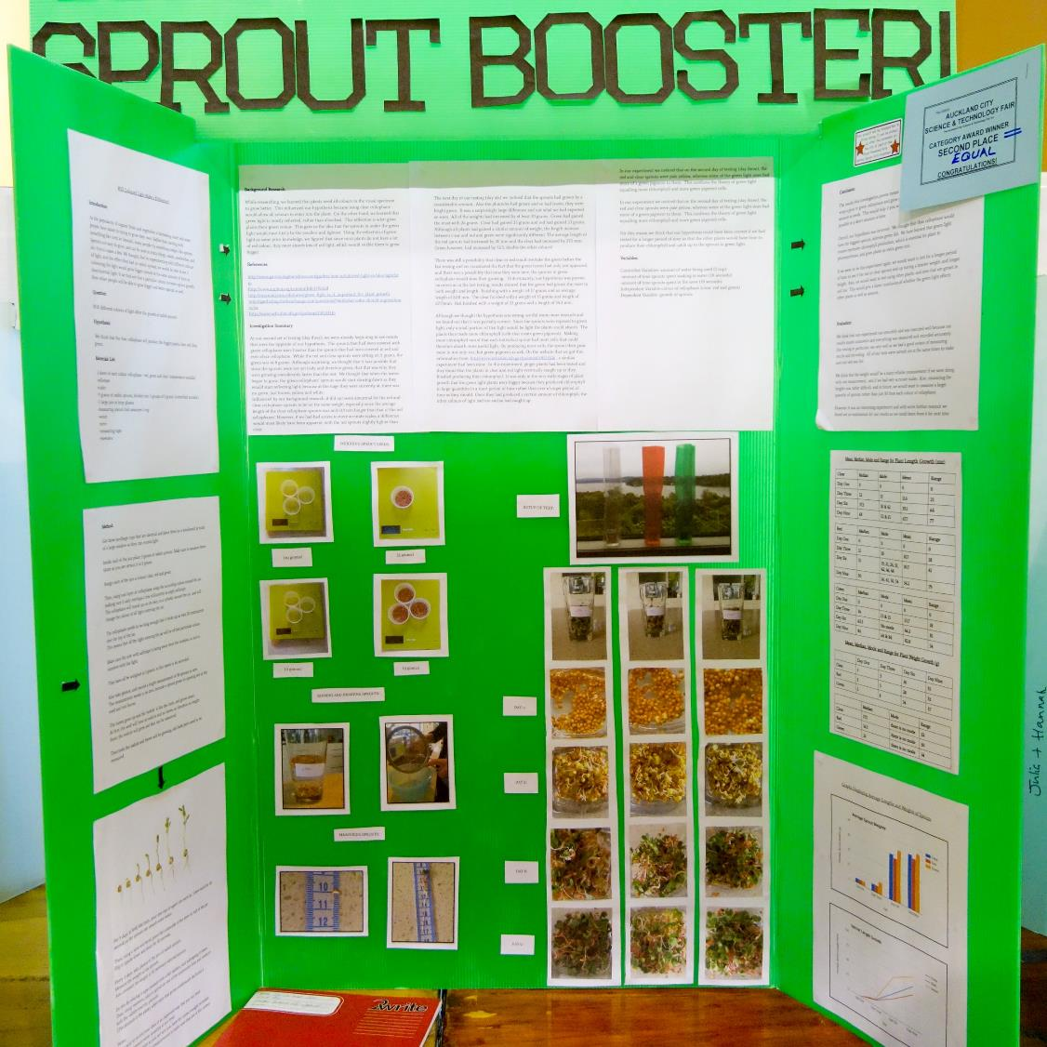
Coloured cellophane and plants… sigh
The point here, though, is that it is done very well. It has to be amazing.

Slide 26
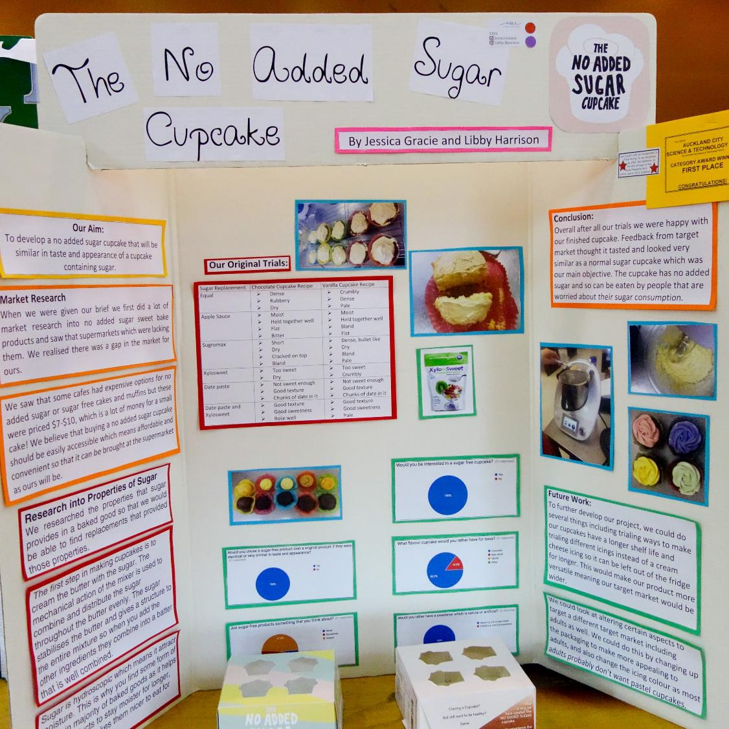
Baking Technology

Slide 27
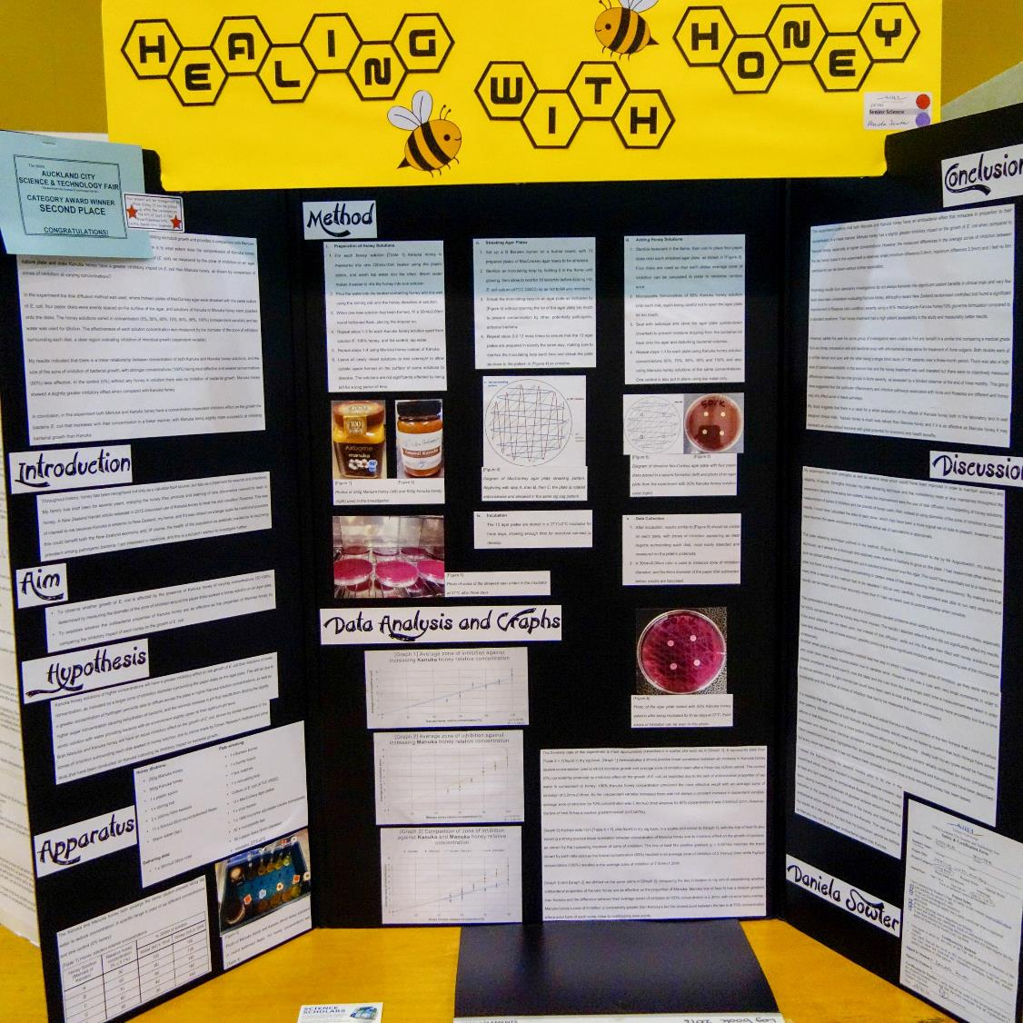
Antibacterial Honey

Slide 28
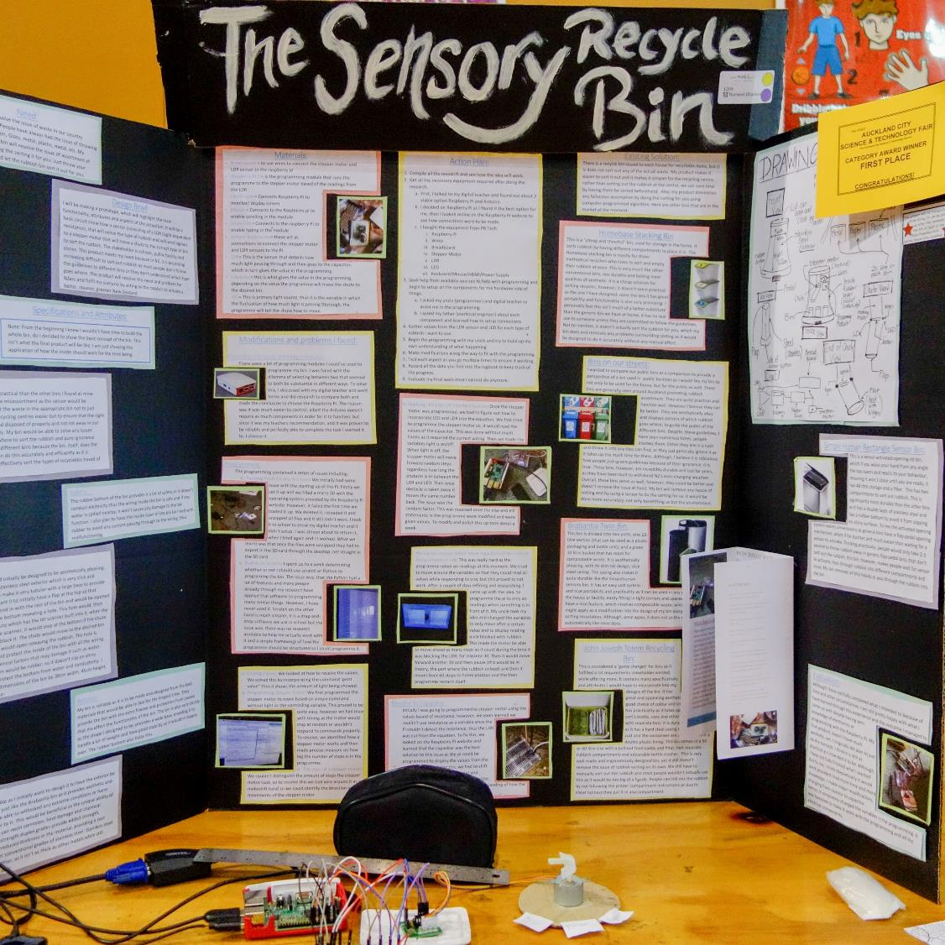
Smart Rubbish Bins

Slide 29
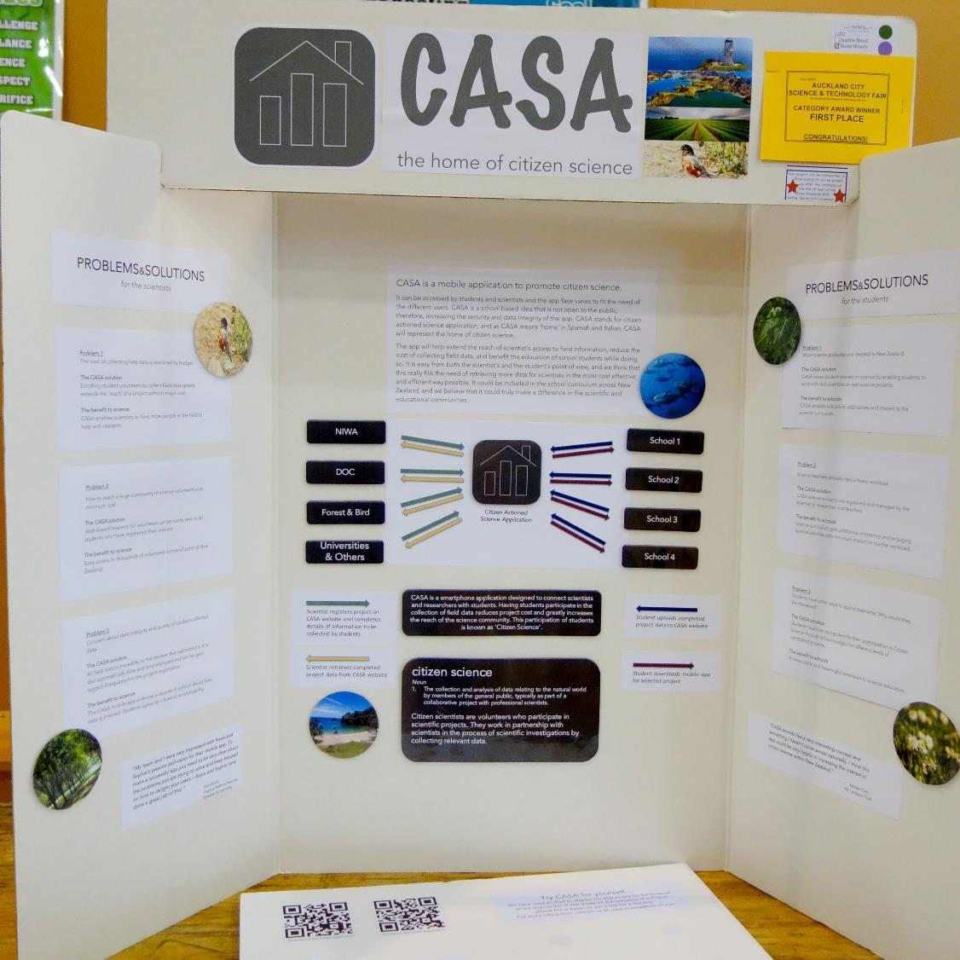
Mobile App to allow public engagement of science data collection

Slide 30
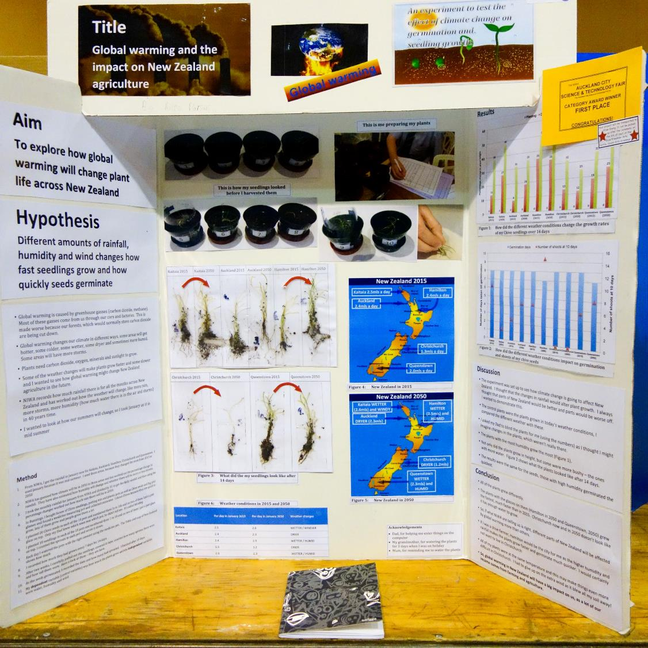
Seed germination factors

Slide 31
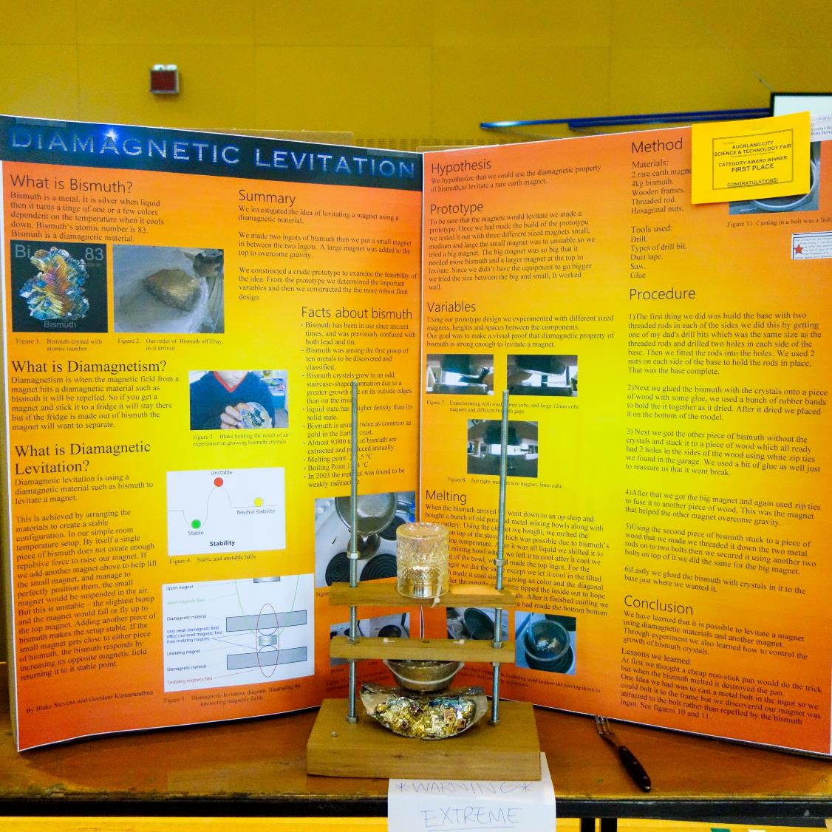
Super Magnets
Plus it’s nice and orange

Slide 32
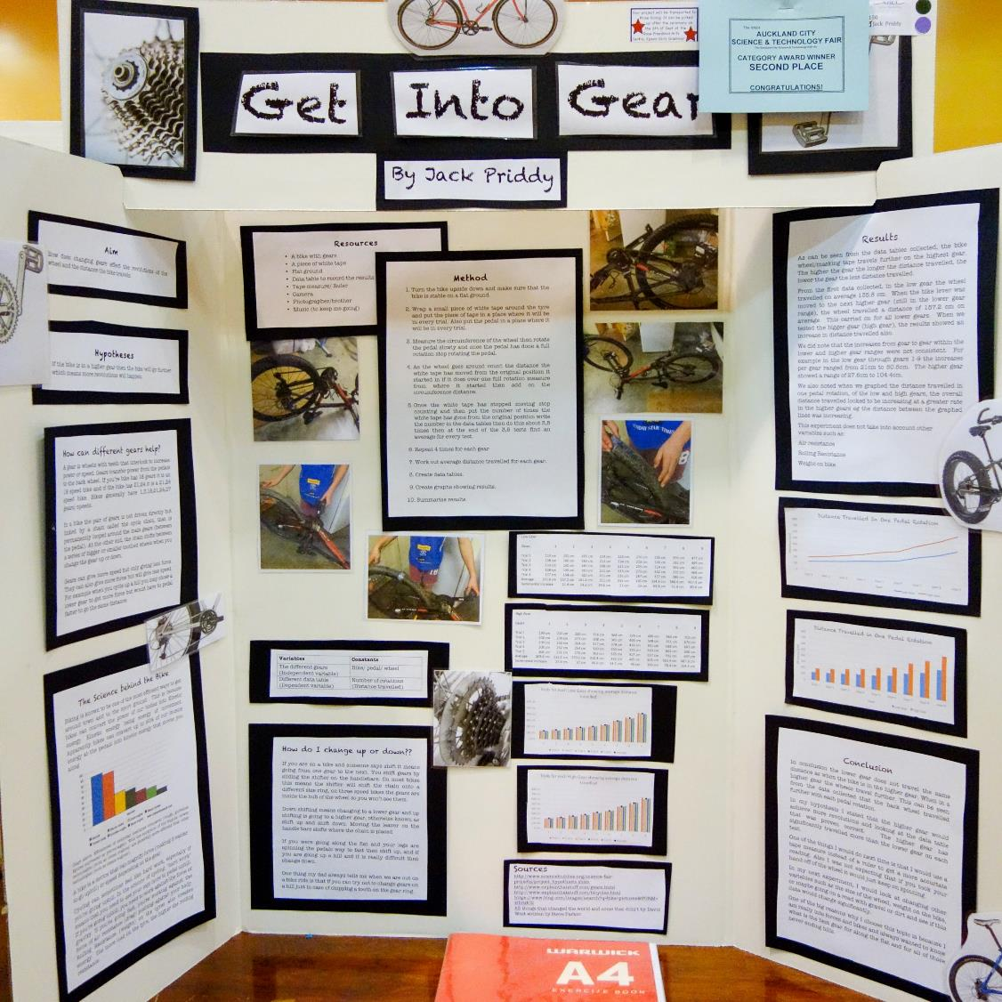
Bicycle gearing

Slide 33
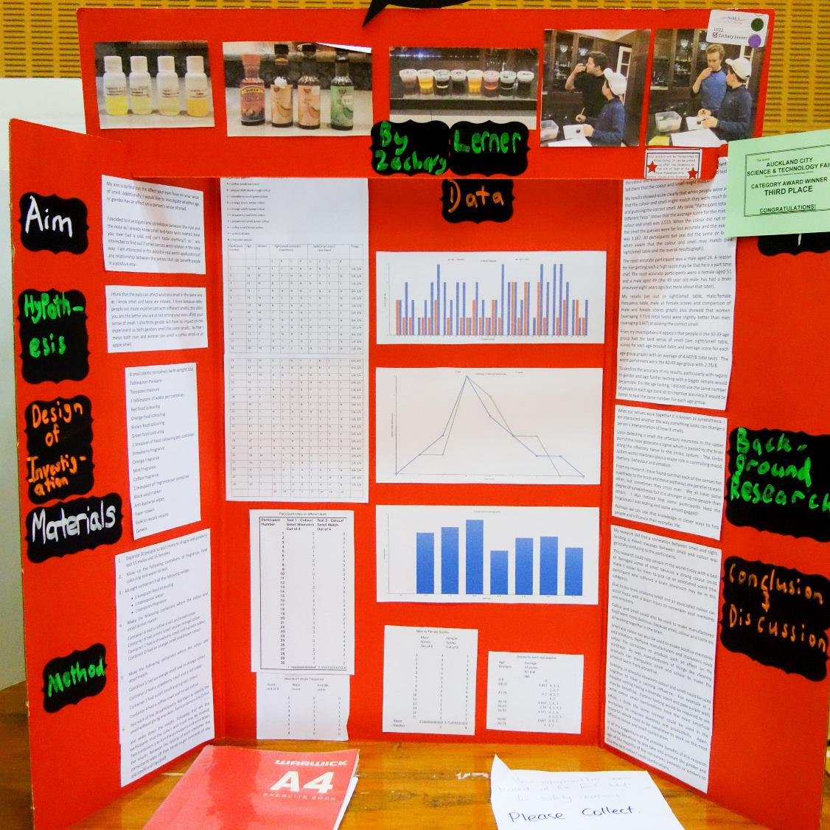
Psychology – interaction of sight and smell

Slide 34
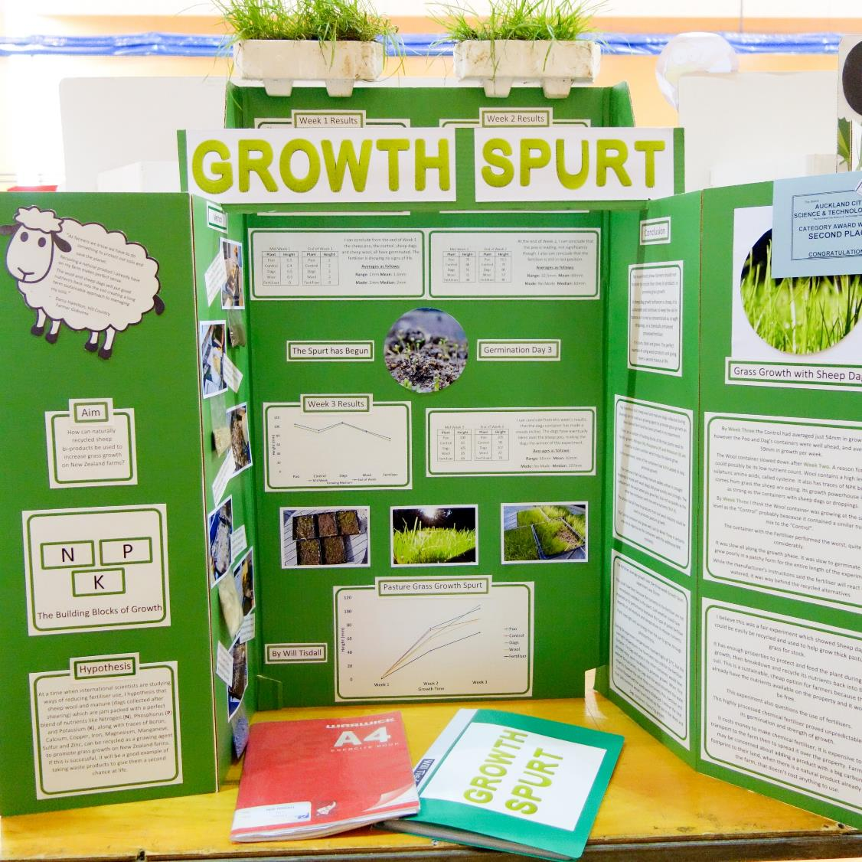
Wool and sheep dags as fertiliser

Slide 35
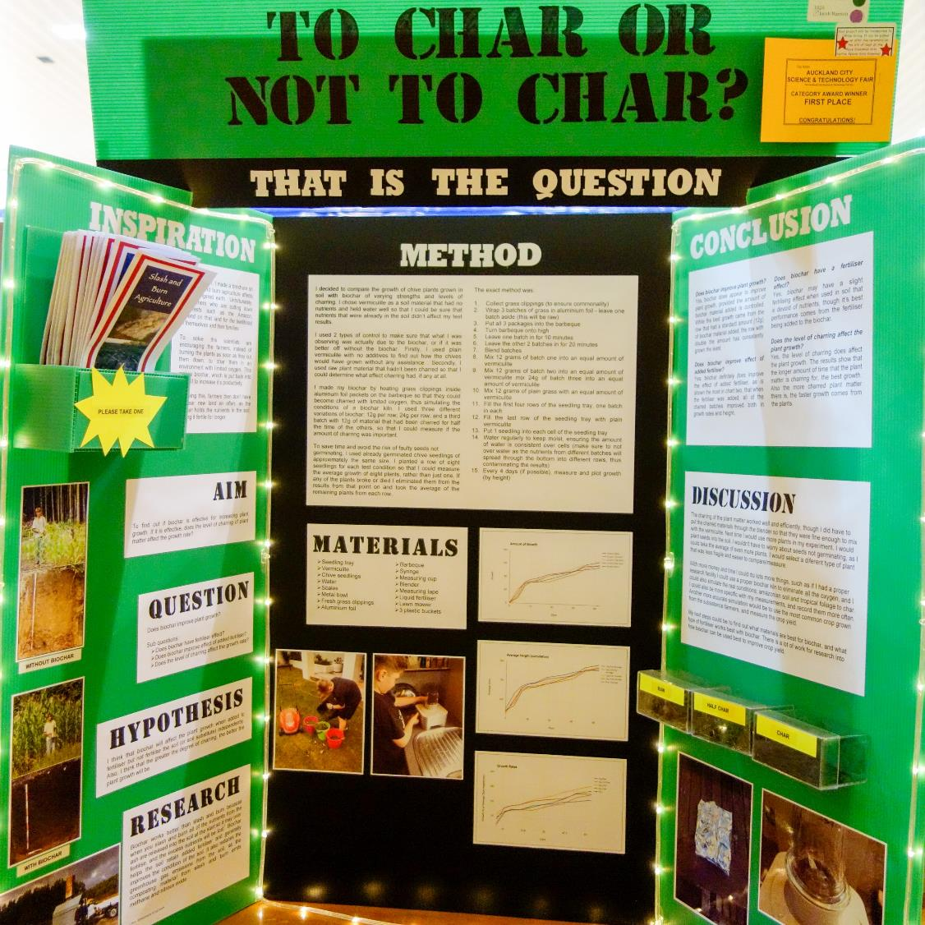
Effectiveness of charing in nutrient uptake – burning off plant growth slowly with limited oxygen.

